Slide 1

LOGIC Circuits

Slide 2

HAPPY NEW YEAR!

Slide 3
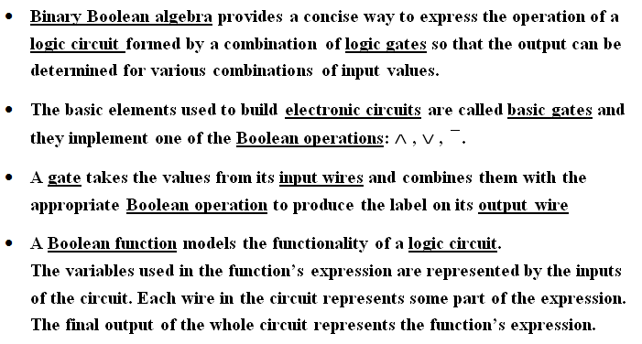
Logic Circuits

Slide 4
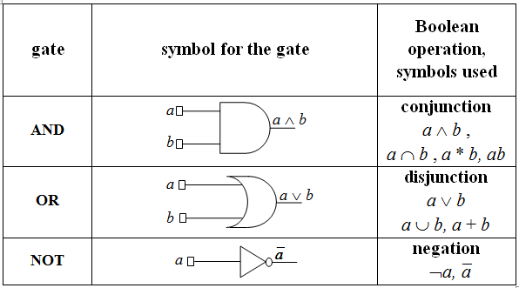
Basic gates – IEEE standards

Slide 5
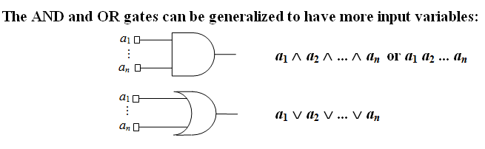
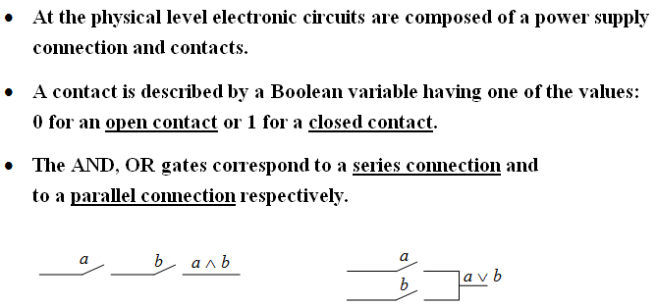

Slide 6
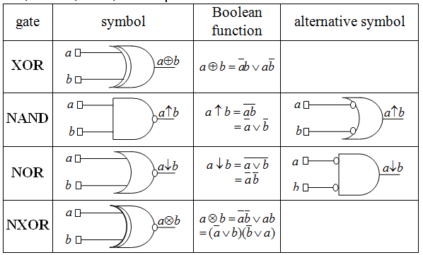

Derived gates: XOR, NAND, NOR, NXOR

Slide 7
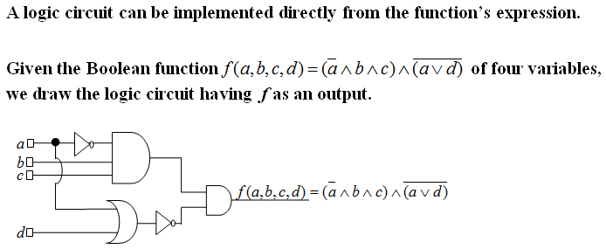
Example 1

Slide 8
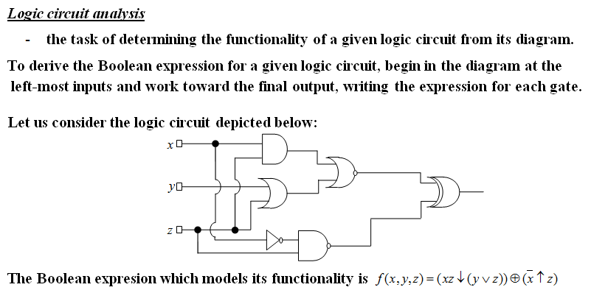
Example 2

Slide 9
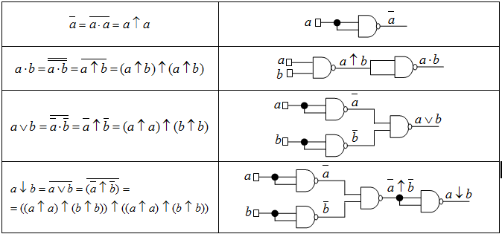
Example 3. NAND is a universal gate -it can be used to produce all the other gates

Slide 10
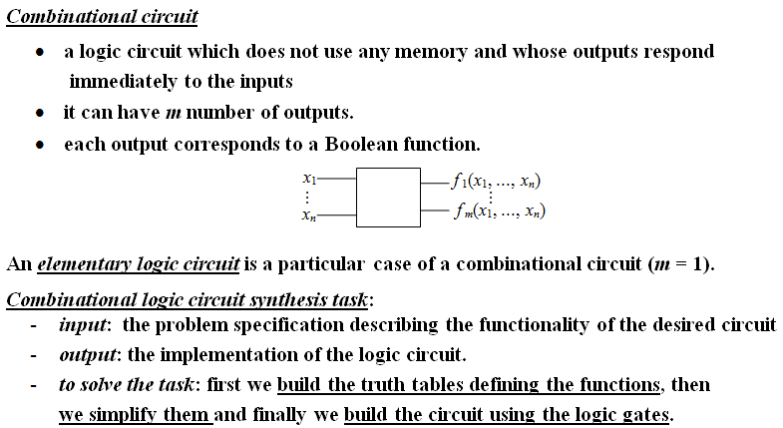
Combinational circuits

Slide 11
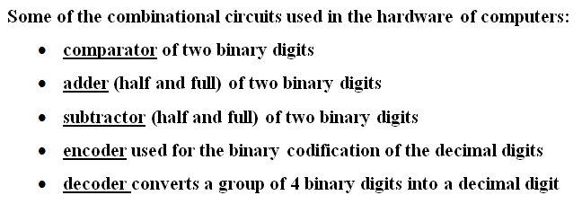
Examples of useful combinational circuits

Slide 12
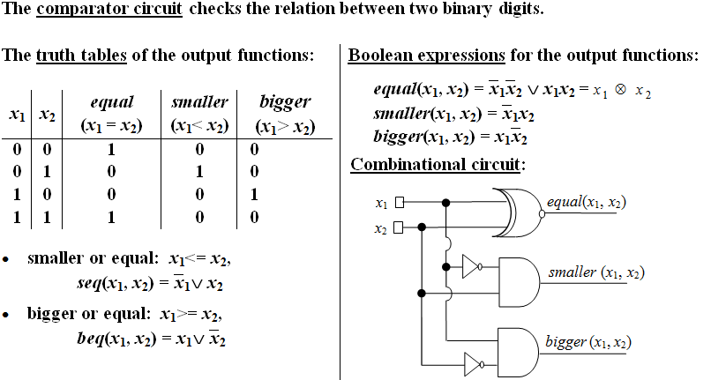
Example 4

Slide 13
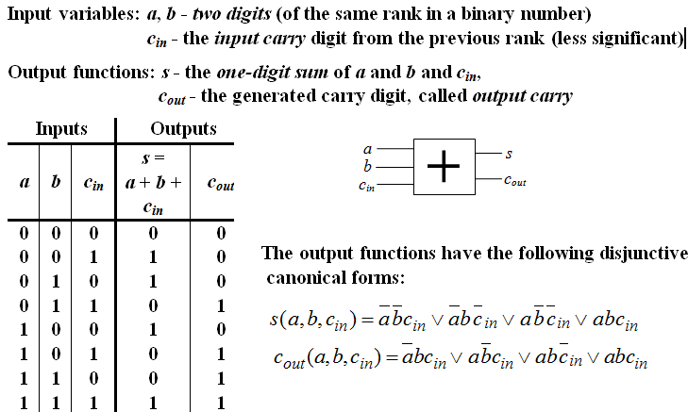
Example 5. Full Adder

Slide 14
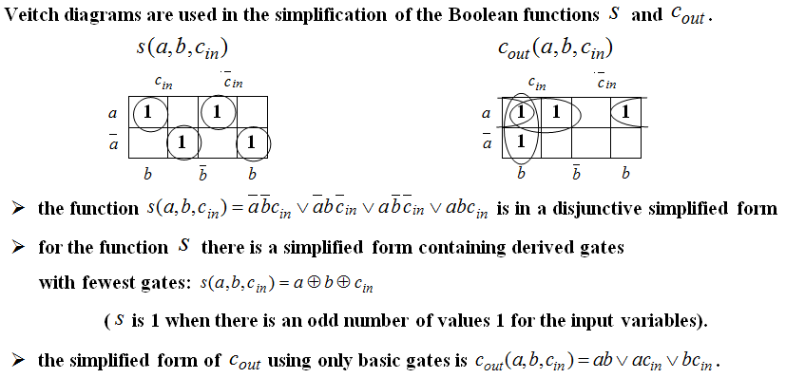
Example 5. Full Adder (contd.)

Slide 15
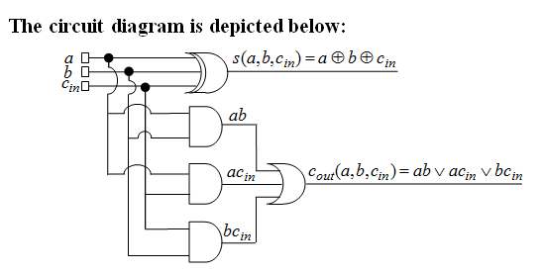
Example 5. Full Adder (contd.)

Slide 16
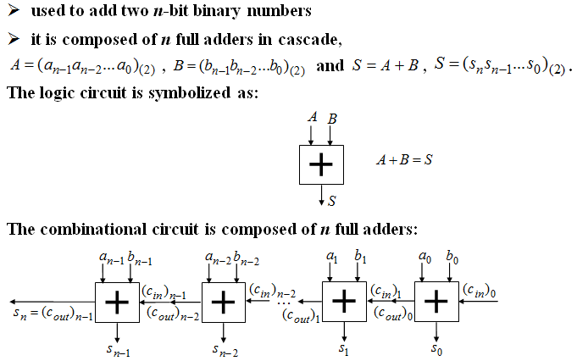
Example 6. n - bit parallel adder

Slide 17
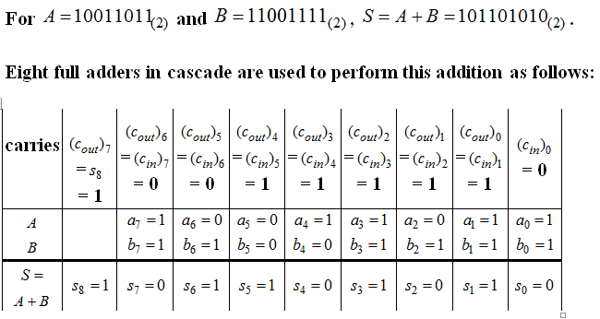
Example 6. n - bit parallel adder (contd.)

Slide 18
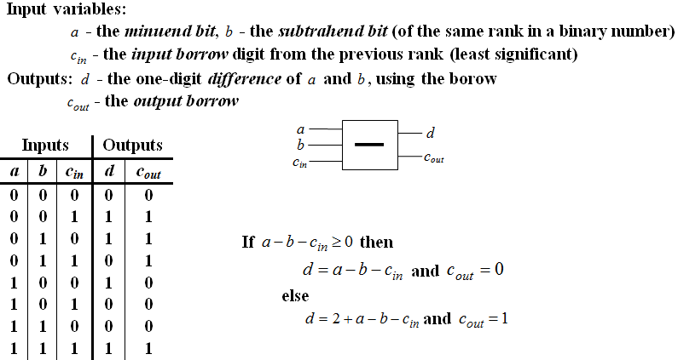
Example 7. Full Subtractor

Slide 19
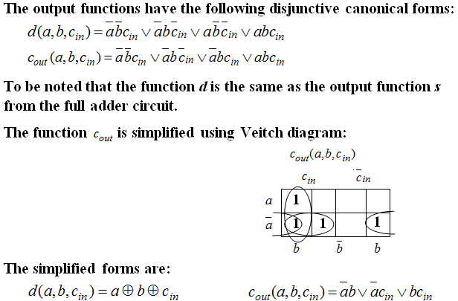
Example 7. Full Subtractor (contd.)

Slide 20
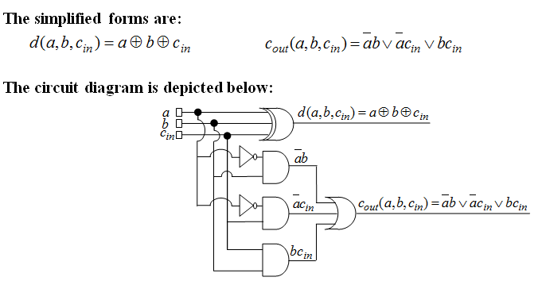
Example 7. Full Subtractor (contd.)

Slide 21
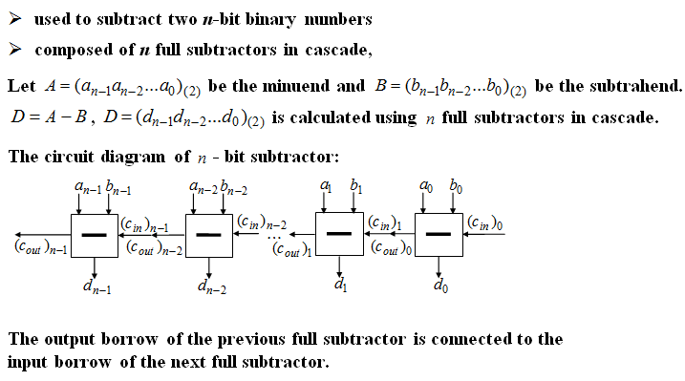
Example 8. n - bit parallel subtractor

Slide 22
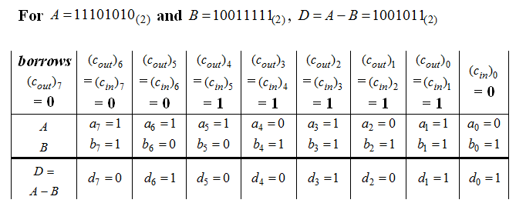
Example 8. n - bit parallel subtractor (contd.)

Slide 23
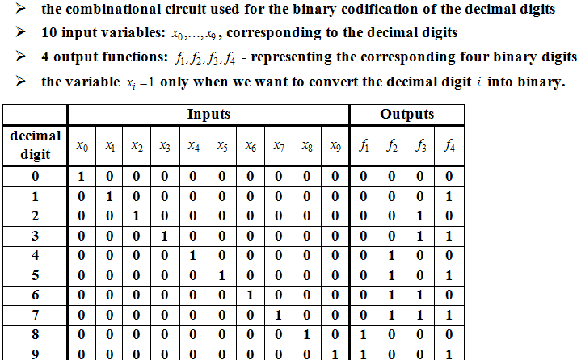
Example 9. Encoder

Slide 24
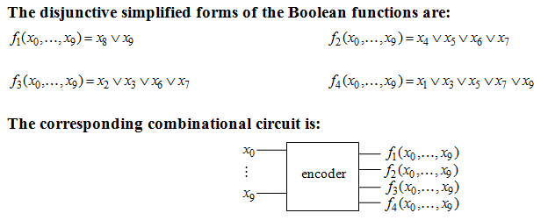
Example 9. Encoder (contd.)

Slide 25
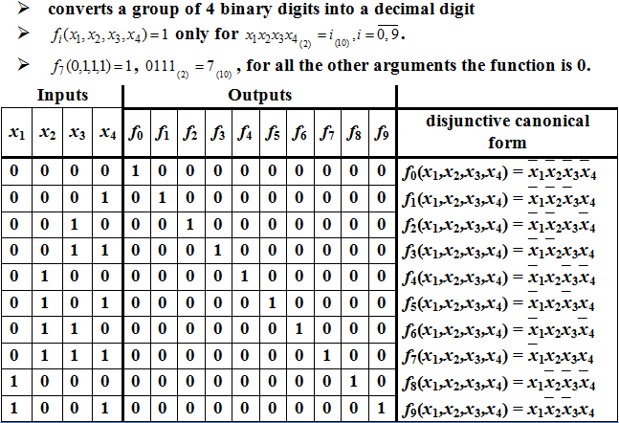
Example 10. Decoder

Slide 26
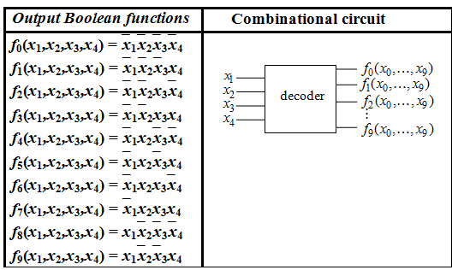
Example 10. Decoder (contd.)

Slide 27
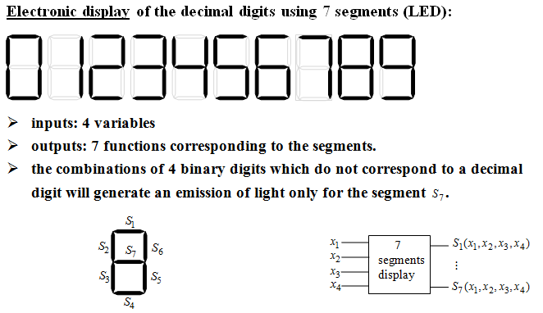
Example 11. 7 segments Circuit

Slide 28
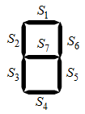
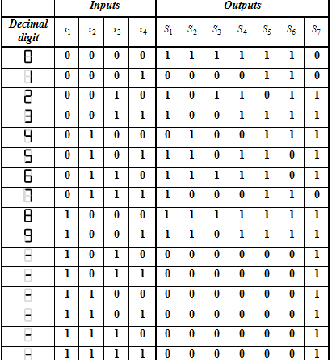
Example 11. 7 segments Circuit

Slide 29
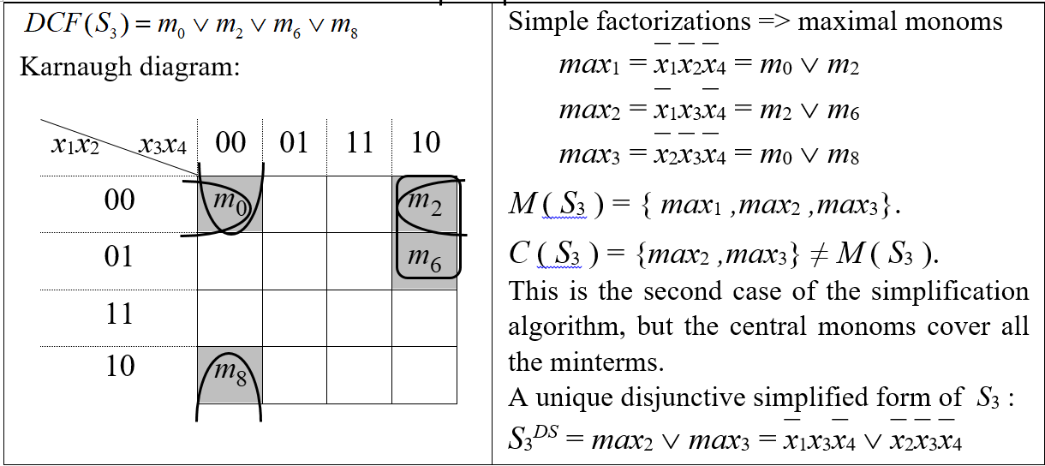
Example 12. Implement the Logic Circuit for S₃ using only NAND gates

Slide 30
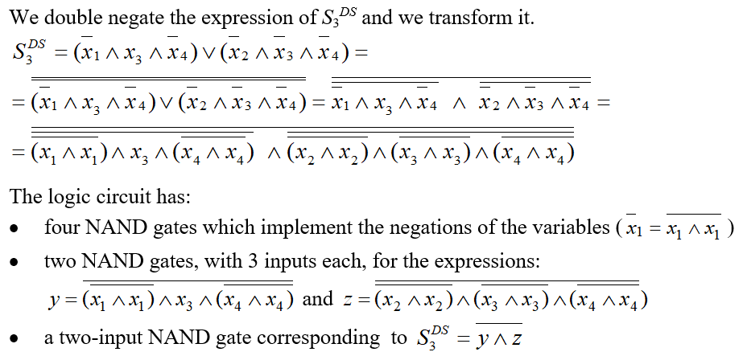
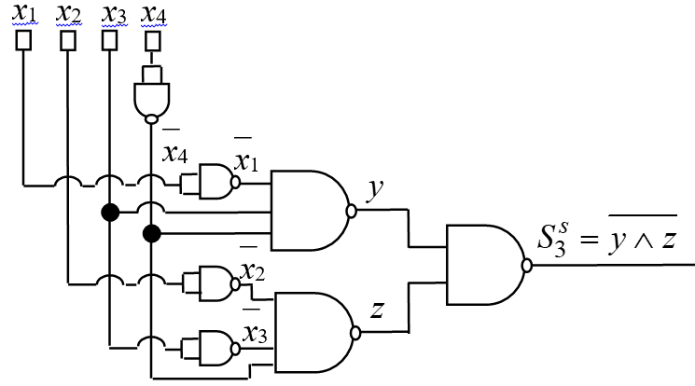
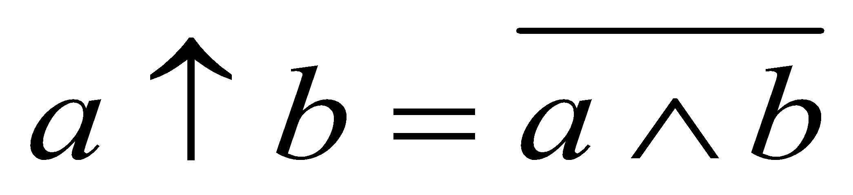
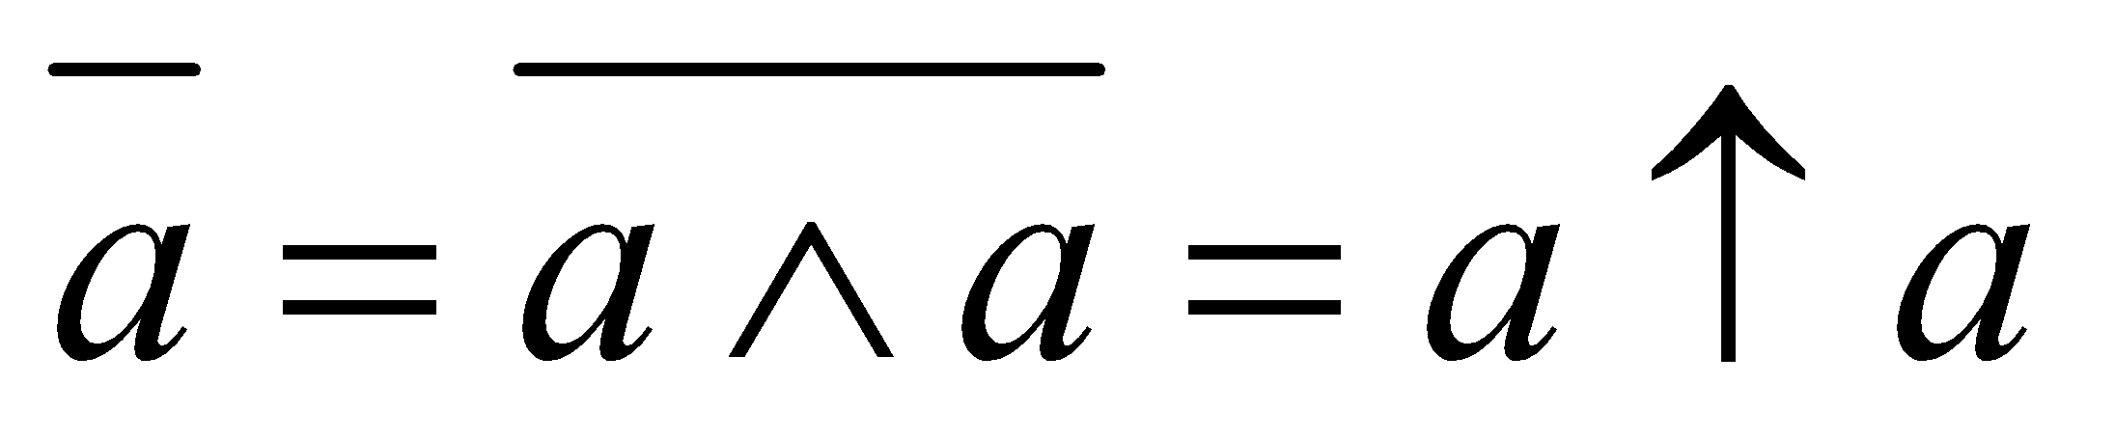
Example 12(contd.)

Slide 31
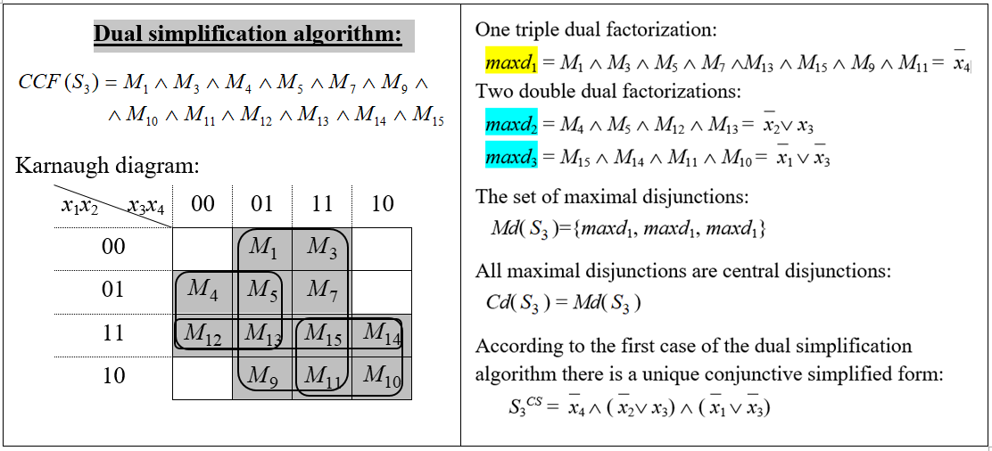
Example 13. Implement the Logic Circuit for S₃ using only NOR gates

Slide 32
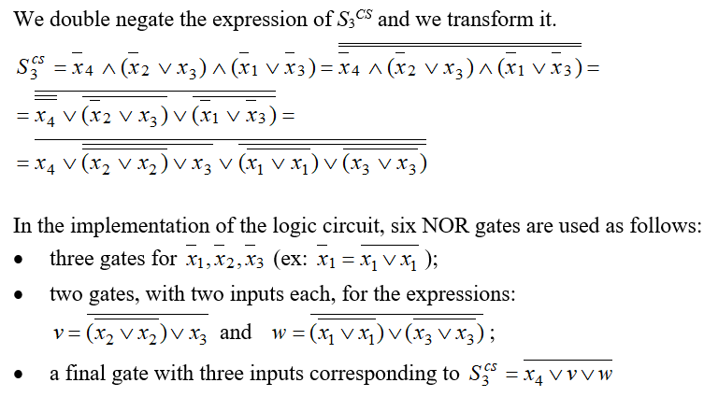
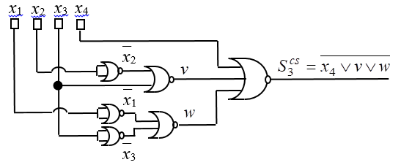
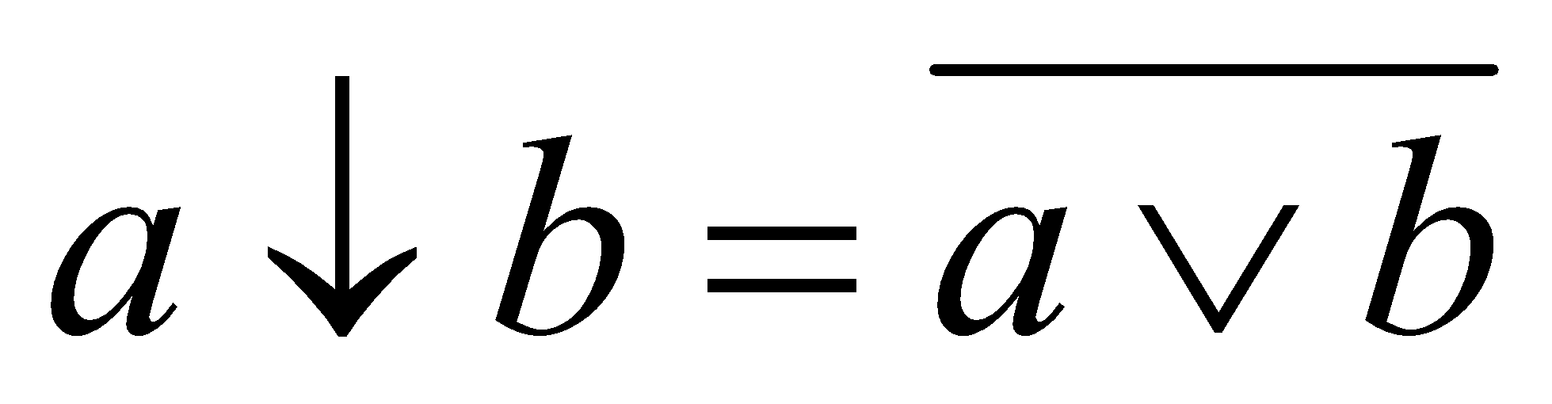
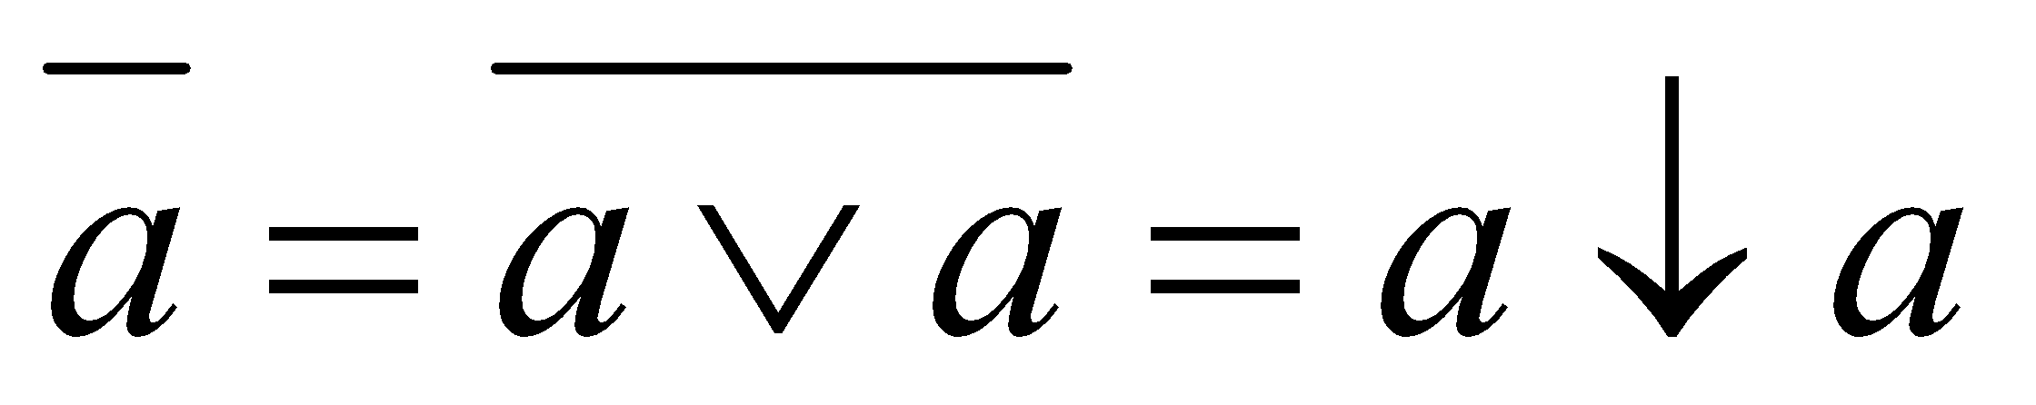
Example 13(contd.)

Slide 33
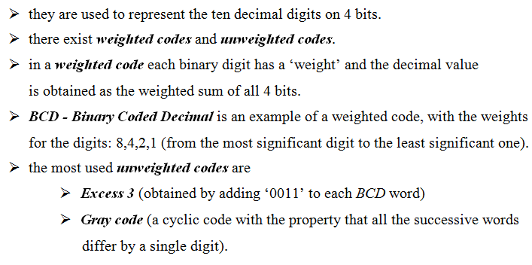
Binary codes

Slide 34
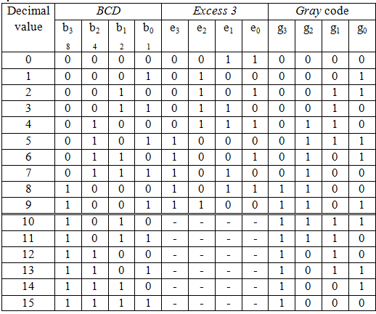
Binary codes (contd.)

Slide 35
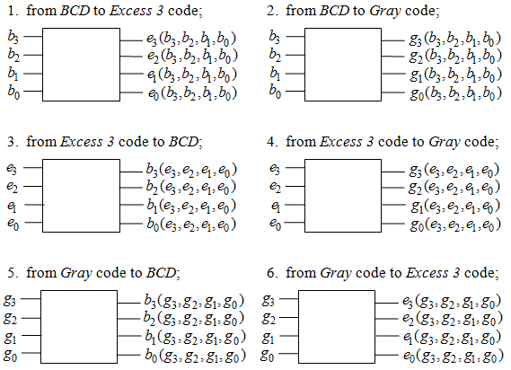
Example 14.

